Slide 1
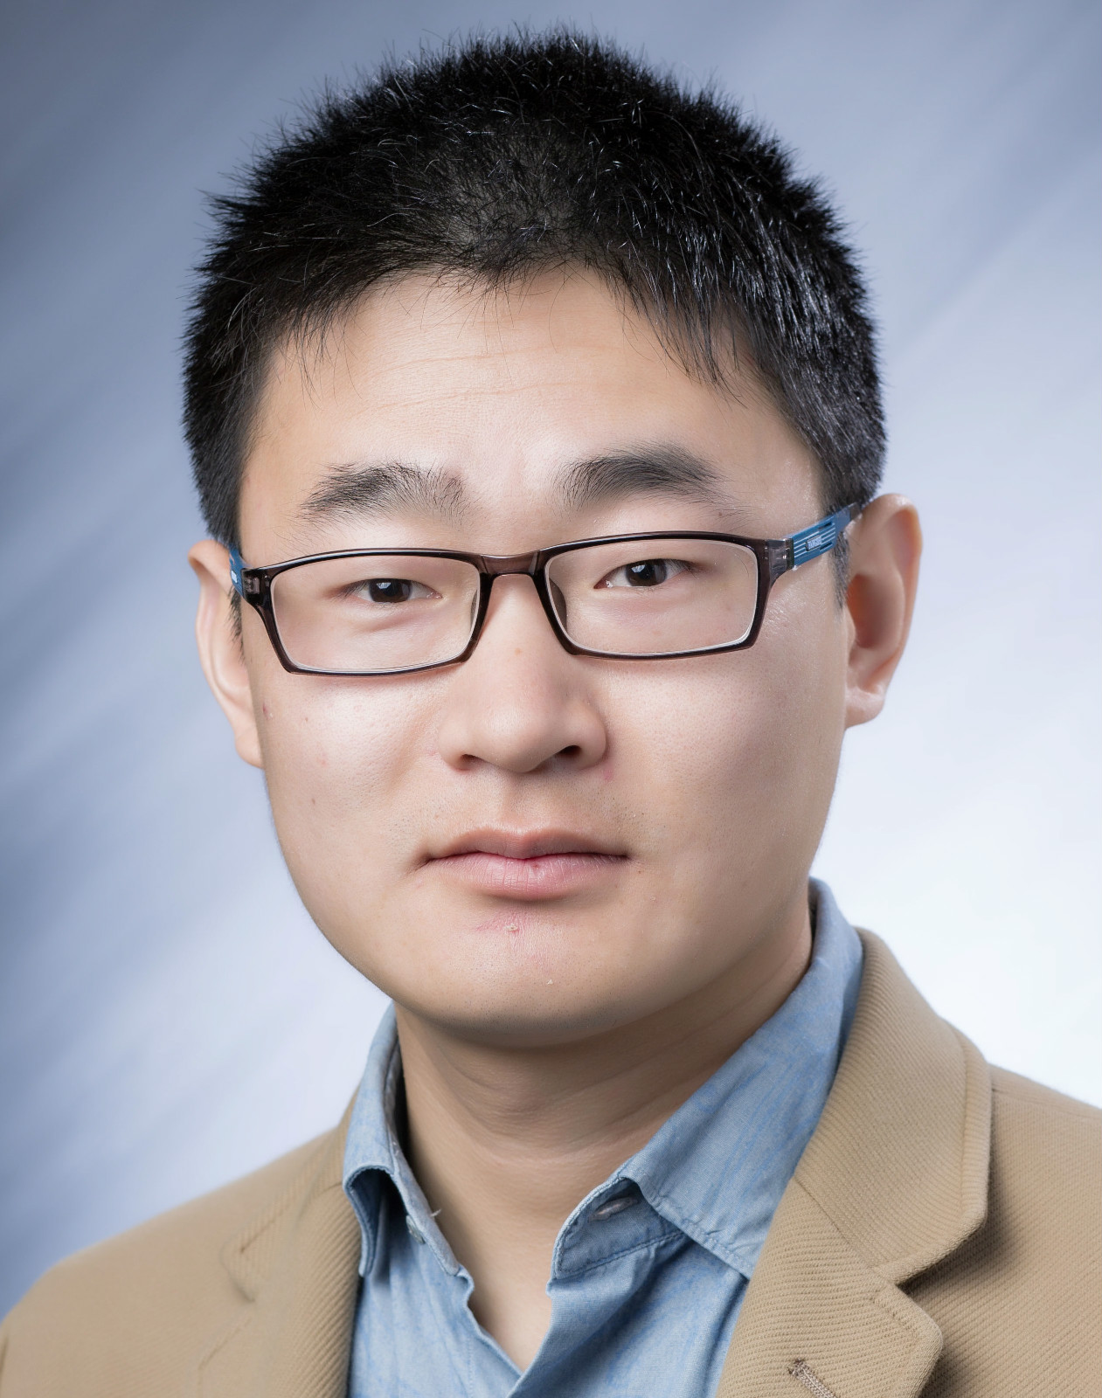

Improving Blockage Robustness in VLC Networks
北京大学高能效计算与应用中心学术报告
Invited Talk, Center for Energy-Efficient Computing and Applications
Dr. Qing Wang
FWO Postdoctoral Fellow in KU Leuven
Host：许辰人 新体制研究员
2018年11月21日 星期三 10:00a
理科五号楼410会议室
Abstract: Visible Light Communication (VLC) has attracted significant attention over the past decade. Although numerous research studies have been performed to improve the data rate of VLC links, an important fact has been largely neglected: users that host VLC receivers could block their line-of-sight downlink channels, and thus, degrade the system performance greatly. In this talk, I will introduce two practical communication systems we have built recently, NutVLC and DenseVLC, to improve the blockage robustness for VLC networks. Both of these systems are built with off-the-shelf devices and are evaluated extensively in realistic environments.
Biography: Dr. Qing Wang is currently FWO Postdoctoral Fellow in KU Leuven, Belgium. Prior to that, he was Postdoctoral Fellow in TU Delft, the Netherlands, and Research Assistant in IMDEA Networks Institute, Spain. His main research interests include Visible Light Communication System and the Internet of Things. He is the co-founder of OpenVLC, a project providing open-source platforms for VLC research. His research has been published at CoNEXT (5), ToN, JSAC, TWC, IoT-J, among others. He has received several competitive awards, e.g. CoNEXT Best Paper Nominee (2016) and Accenture Innovation Award (2017).

